Slide 1
CMPE259 NATURAL LANGUAGE PROCESSING nlp Trends presentation VECTOR DATABASES
Meera Tresa Sebastian

Slide 2
INTRODUCTION
Recently vector databases got a lot of fame with companies raising hundreds of millions of dollars to build them and people calling it a new kind of database for the AI era.

Slide 3
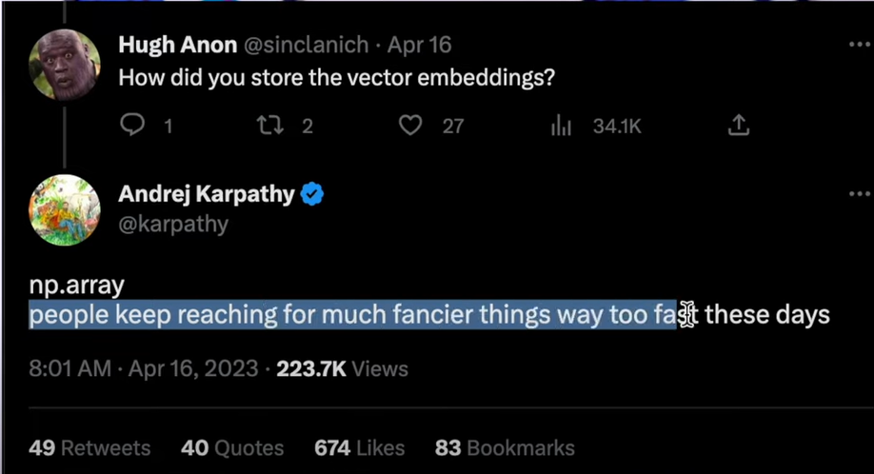
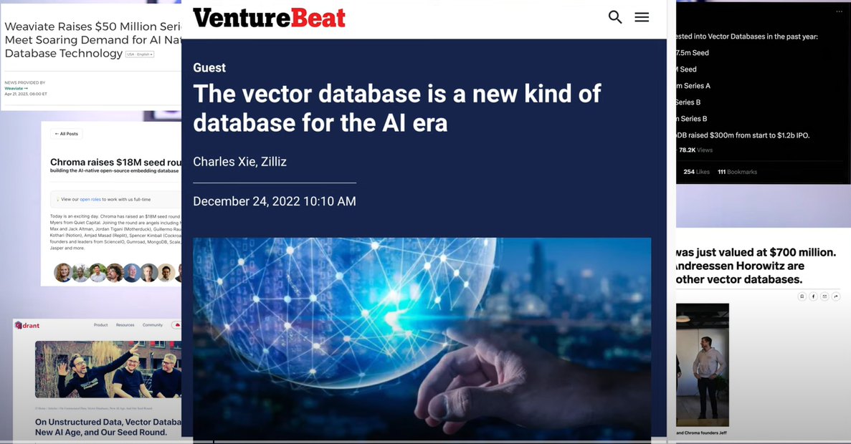
Link

Slide 4
AGENDA
What is a Vector Database?
Application in LLM Use cases
Current Landscape

Slide 5
What is a Vector Database?

Slide 6
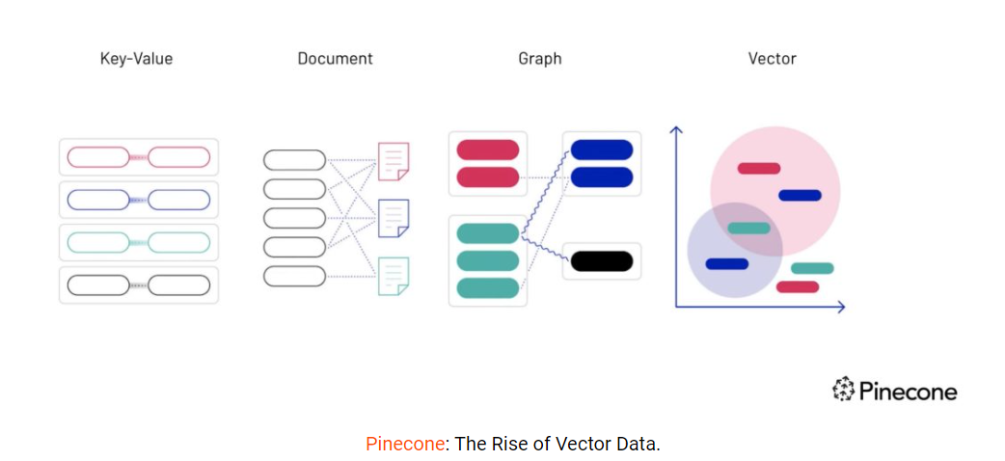
What is a Vector Database? Vectors need a new kind of database
The vector database stores data such as text, image, and audio in the form of vectors. It indexes and stores vector embeddings for fast retrieval and similarity search.

Slide 7
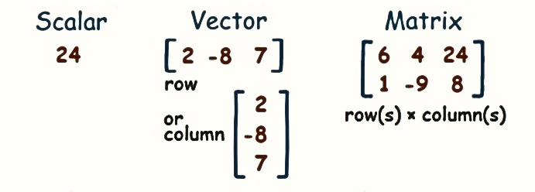
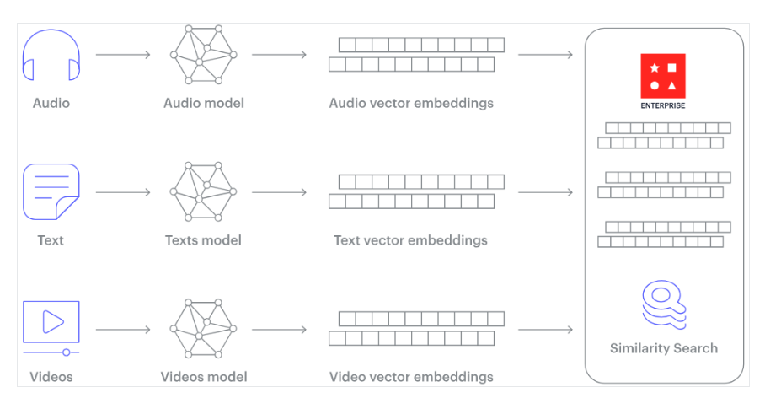
What is a Vector Database? What is vector data?
A vector is a list of numbers(can be in row or column)
Each data type, whether it’s an image, audio, or text must be transformed
Eg: Word Embeddings

Slide 8
What is a Vector Database? SIMILARITY search
Search results are limited when they do not incorporate meaning or context
Proliferation of unstructured data created a huge gap in the effectiveness of traditional keyword matching and filtering.
Every organization that stores non-textual data – and that’s just about everyone – can benefit from improving search functionality across unstructured data.
Vector Similarity Search (VSS) is a key feature of a vector database. It is the process of finding data points that are similar to a given query vector in a vector database.
Notes:
A vector database is a type of database that stores data in the form of vectors or mathematical representations of data points. AI and machine learning is what is enabling this transformation of unstructured data into numeric representations (vectors) that capture meaning and context, benefiting from advances in natural language processing and computer vision.
Vector Similarity Search (VSS) is a key feature of a vector database. It is the process of finding data points that are similar to a given query vector in a vector database. Popular VSS uses include chatbots, recommendation systems, document search, image and video search, natural language processing, and anomaly detection.

Slide 9
Application in LLM Use cases

Slide 10
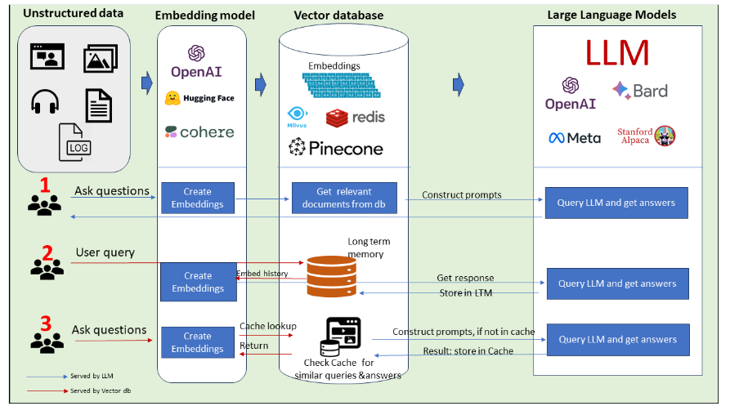
Application in LLM Use cases
As a knowledge base to provide ‘context’ from the enterprise aka RAG ( Retrieval Augmented Generation).
Acting as long-term LLM Memory
Cache previous LLM queries and responses
Link
Notes:
Vector databases and LLM complement each other very well. Three most efficient ways in which vector databases amplify LLM use cases and ensure better ROI.

Slide 11
A glimpse into the current landscape

Slide 12
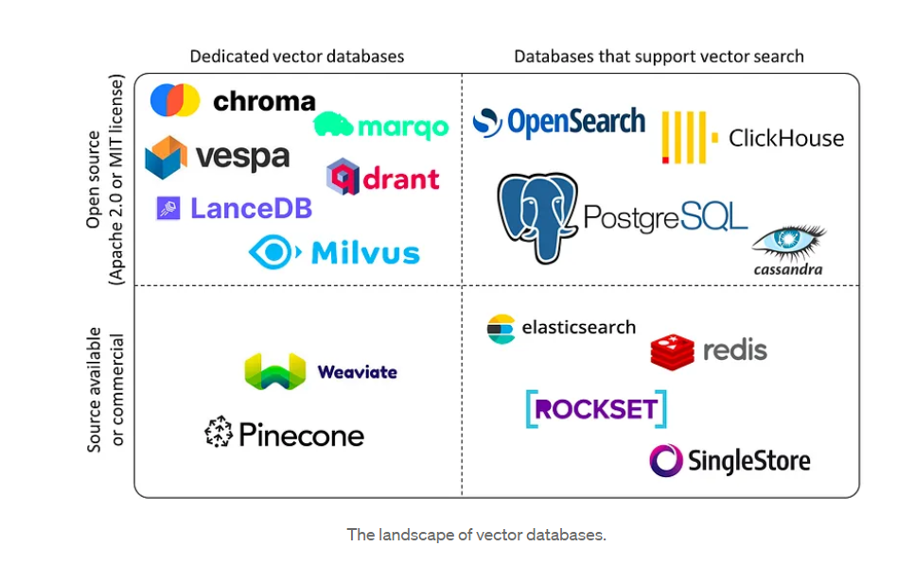
current landscape
Link1 Link2
Notes:
In cases where a company possesses a strong technological foundation and faces a substantial workload demanding advanced vector search capabilities, its ideal solution lies in adopting a specialized vector database. On the other hand, if a company has already adopted commercial databases like Elastic, Redis, SingleStore, or Rockset and does not necessitate highly advanced vector search capabilities, they can fully utilize the existing functionality of these databases. Many databases are considering incorporating vector search capabilities to meet the demands of their current user base. For databases that currently lack vector search functionality, it is only a matter of time before they implement these features. Eg: MongoDB Atlas Vector Search

Slide 13
THANK YOU

